Slide 1
CF to Kubernetes migration

Slide 2
Migration concept
Provide a Cloud Foundry application developer to quickly able to migrate and deploy on to a Kubernetes environment, be it an OpenShift or IBM Cloud Private environment
Minimize learning curve needed to deploy and develop application on a new platform
Pre-requisites:
Known application type (known buildpack)
Known service bindings
Manifest file

Slide 3
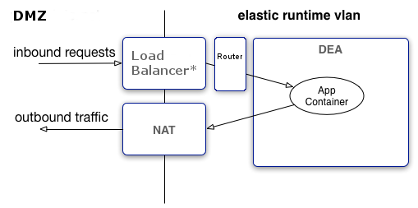
CloudFoundry application architecture
CloudFoundry
Backend Service
Service Broker
Backend Service
VCAP SERVICES
Backend Service

Slide 4
Kubernetes application architecture
Kubernetes cluster
Worker Node 1
Pod
App A
Container
Unit packaging of an app
Pod
Smallest deployment unit in Kubernetes
A collection of containers that run on a worker node
Service
Collection of pods exposed as an endpoint
Types
ClusterIP – link service to a cluster-internal IP
NodePort – link clusterIP to each Node’s IP port
LoadBalancer – link multiple NodePorts externally using the cloud provider’s load balancer IP
Ingress
Addressable unit to allow access to NodePorts from external network
ConfigMap & Secret
Configuration information that pod uses
Can be used to access back-end services
Backend Service
Ingress Gateway
App A Service
config map
Worker Node 2
Pod
App A

Slide 5
Application Staging
CloudFoundry
Kubernetes
All the following are performed by cf push
The CLI uploads application artifacts to CloudFoundry
CloudFoundry selects the appropriate BuildPack
BuildPack prepares the artifacts to create a runnable unit (Droplet)
CloudFoundry stores the Droplet in the Blob store
CloudFoundry deploys the Droplet into its Runtime as a Garden Container and provides VCAP_SERVICES to access backend services
CloudFoundry associates the appropriate Router entry
Build and assemble the necessary deployment artifacts
Create a docker image using a Dockerfile and store the image in a Docker repository docker build … docker push …
Create ConfigMap and Secrets to access backend services
Use deployment YAML to deploy docker image into a Kubernetes Pod in a Deployment or DeploymentConfig kubectl apply -f …
Use the Service YAML to associate the pods to a Kubernetes Service and optionally define it to an Ingress Gateway or OpenShift Route kubectl apply -f …

Slide 6
Migration approach
Allow developer to understand the process to deploy in Kubernetes
Build additional configuration files that should not change much provided the application is not changed significantly
Let developer to deploy manually to Kubernetes or load the process to automatically deploy using Jenkins pipeline
Prevent automation to create generic migration tool to have a CF application run directly in Kubernetes using buildpack simulation (ie https://buildpacks.io)
Tools should be run just once when developer need a quick jump-start into Kubernetes

Slide 7
Migration script
The cf-migrate flow (Runtime/Buildpack specific):
Extract application artifact (get_source.sh)
Generate application configuration (server_xml.sh and vcap-liberty.sh for liberty)
Generate Dockerfile (create_dockerfile.sh)
Generate deployment yaml files (create_yaml.sh)
Generate Jenkinsfile (not in MVP)
Produce readme of what artifacts are produced and how to invoke the deployments

Slide 8
Migration tool prerequisites
Prerequisites:
bash
jq
git
curl
xmlstarlet
maven or gradle
Or use the provided Docker image: ibmcloudacademy/cfmigrationtool
Get the container image:
docker pull ibmcloudacademy/cfmigrationtool
Use a path from the host that you will use to store the output, assuming that you use /Users/ibmuser/data:
docker run --net=host -v /Users/ibmuser/data:/data -it ibmcloudacademy/cfmigrationtool bash

Slide 9
Running migration tool
Download the tool from GitHub:
git clone https://github.com/ibm-cloud-architecture/cf-transformation
Change the directory to the migrate sub-directory:
cd cf-transformation/migrate
Get the content of your application VCAP_SERVICES from Cloud Foundry (optional):
cf env <appname> > vcap.json
Run the migration tool against your source:
./cf-migrate.sh -s <source> -t <tempdir> -b <app type> -e <target type>
-s: migration source, can be local path or a HTTPS git repository link
-t: the processing and result path, useful for defining container shared path
-b: application or buildpack type (ibm-websphere-liberty, java, nodejs)
-e: target type (openstack, iks, icp)

Slide 10
Sample output

